Slide 1


WELCOME!
IFSW Europe Delegates Meeting 2026, Utrecht, the Netherlands

Slide 2
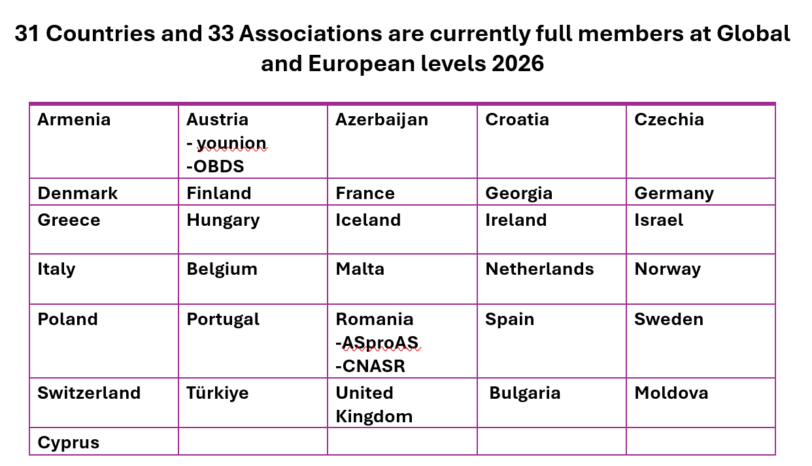

Slide 3

Priorities for IFSW Europe
Equal participation: Supporting and including all countries including those more marginalised or under duress
Building our organisational strength and resources for the future
Representing and advocating for social work and social care across governments and regional bodies
Advancing priority areas of professional development

Slide 4
Building Stronger Member Associations
‘Strengthening Social Work across Europe (SSWAE) – produce solidarity and support framework from IFSW E for more marginalised members and those under political and other duress – by March 2027
Continue to develop the purpose and deliverables of SSWAE steering group
Hold member webinar on support for social workers under duress by March 2026.
Explore regional workshops in Balkan countries in partnership with European Association of Schools of Social Work in 2027
Continue to develop concept of decolonisation in social work as it applies within Europe
Extend SSWAE outreach to new and lapsed members to increase membership
Evaluate and publish short report on SSWAE by end January 2026 and produce revised plan up to October 2027

Slide 5
Influencing European and National Social Work Policies
EU Funded Responsive Project
Promote impact of the Responsive project through dissemination of social work guidance including in webinars at European and country level
Explore opportunities for an EU partnership Erasmus bid for implementation of the research and guidance
Liaise with and build relationships and possible new collaborations with Responsive consortium partners

Slide 6
Influencing European and National Social Work Policies
Offer support and advice to national associations on specific social work and workforce development challenges and strategies e.g. supporting approaches to governments and policy makers
Develop our relationship and collaboration with other IFSW regions through six -monthly online meetings and planning further joint activities for 2027 and the 2028 Paris conference.
Develop our visibility and presence at European level bodies deadling with social work and social services i.e. EU, CoE, cross nation organisations for social services,

Slide 7
Promoting social work practices and common identity across Europe: celebration, development and defence of social work
Hold mid-year online members meeting to sustain relationships and sense of community
Create a regular model event for World Social Work Day to bring members together to explore global agenda themes, from March 2027
Continue to offer in person and online contributions to diverse members’ conferences and events throughout the year (e.g. President, Vice President, other ExCo members)
Regularise member briefings to quarterly publication and share non-confidential content through the website and social media

Slide 8
Practice topics: Social Work in Disasters and Emergencies
Explore and develop possibility of IFSW E online community of practice for disasters and emergency social work
Hold one or more webinars in conjunction with experts in this firled
Advocate for the role of social workers in EU resilience and responsiveness to disaster workstreams

Slide 9
Practice topic: Social work with older people
Promote the position paper on older people’s rights if adopted by IFSW E DM 2026, in preparation for proposed UN convention of rights of older people, supported by our UN Regional Support team members, Gerry Nosowska
Share the European statement on older people with all regions, gain feedback and propose Global position development for General Assembly in Paris, 2028

Slide 10
Practice topic: Social Work with Roma and Traveller people
Build the visibility of our representative in Roma and Traveller Rights division of the Council of Europe work through reports, blogs, social media posts and a webinar on Roma rights and social work – first half of 2027
Develop/curate learning resources and hold one or more webinars for members and social workers – first half of 2027

Slide 11
Practice topic: Eco-social next steps
Maintain and develop the eco-social steering group as a Community of Practice and Research, meeting quarterly.
Roll out ‘Envisioning sessions’ across member states, providing basis for developing guidance for mainstream social work practice
Develop and submit Erasmus or other bid for funding in Spring 2027

Slide 12
Practice topic: Artificial Intelligence and Digital Technology
To be considered after the DM 2026

Slide 13
SUPPORTING SOCIAL WORKERS’ WORKING CONDITIONS
Further to the DM 2026 workshop and views of members about Working Conditions as a mandate for IFSW E, develop the Hellenic/UK project to provide resources, policy statements and/or advocacy tools for associations and social workers across Europe
Work with members who are also Trade Unions on possible project creating common working standards for social workers across Europe

Slide 14
Advocating for European Social Work Within European and Global Bodies
Continue to develop the representatives including regional commissioners and hold training and reflection sessions in regular online meetings to improve confidence and skills in advocating for social work with policy makers, researchers, governments etc
Seek further opportunities for European level influence and visibility e.g. through developing presence in EU Commission and associated bodies, developing more partnerships with influential organisations and increase social media output

Slide 15
Improving internal and external communications
Continue to produce and refine the quarterlymembers newsletter.
Work with the NSWN, our representatives and other members to increase our online content and reach. We will seek assistance within the membership for ‘easy wins’ in information dissemination and online presence.
Keep communications as a focus area for growth and development in 2026/7
Seek further ideas from the members in DM 2026 particularly on member networking

Slide 16
Securing our Finances and Development
Set a prudent budget that keeps our reserves around 100k euros
Continue outreach to new and lapsed members to increase membership and therefore fees collected
Pursue existing projects in development and seek other opportunities to be part of funded research and other bids for resources
Establish and provide admin support for a focused ongoing working group of experts in bidding, academic partnership development, fundraising through other means (e.g. philanthropy) and income generation. Aim to create a minimum surplus of £50k euros by end of 2027

Slide 17
Delivering the IFSW Europe Conference
Finalise the contracting with Hellenic Association by November 2026
Establish involvement of IFSW E in the management and scientific committees
Promote the conference widely through our membership and networks
Support the Hellenic Association in delivering a conference successfully for the profession and participants, and with a surplus.

Slide 18
Planning for the future and supporting all generations of social workers
Support the NSWN with advice, mentoring and encouragement
Carry forward unspent monies from the budget 2025/6
Support the network in fundraising for its own activities
Promote the position statement on intergenerational social work if approved by the DM 2026.
Measure levels of NSW involvement amongst our members and report in DM 2027

Slide 19
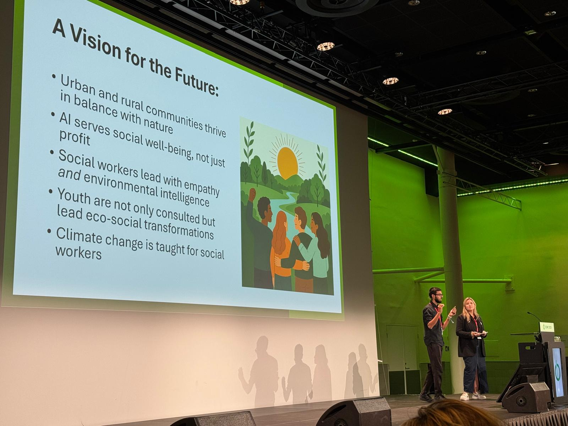
Encourging the next generation of social workers and social care professionals

Slide 20
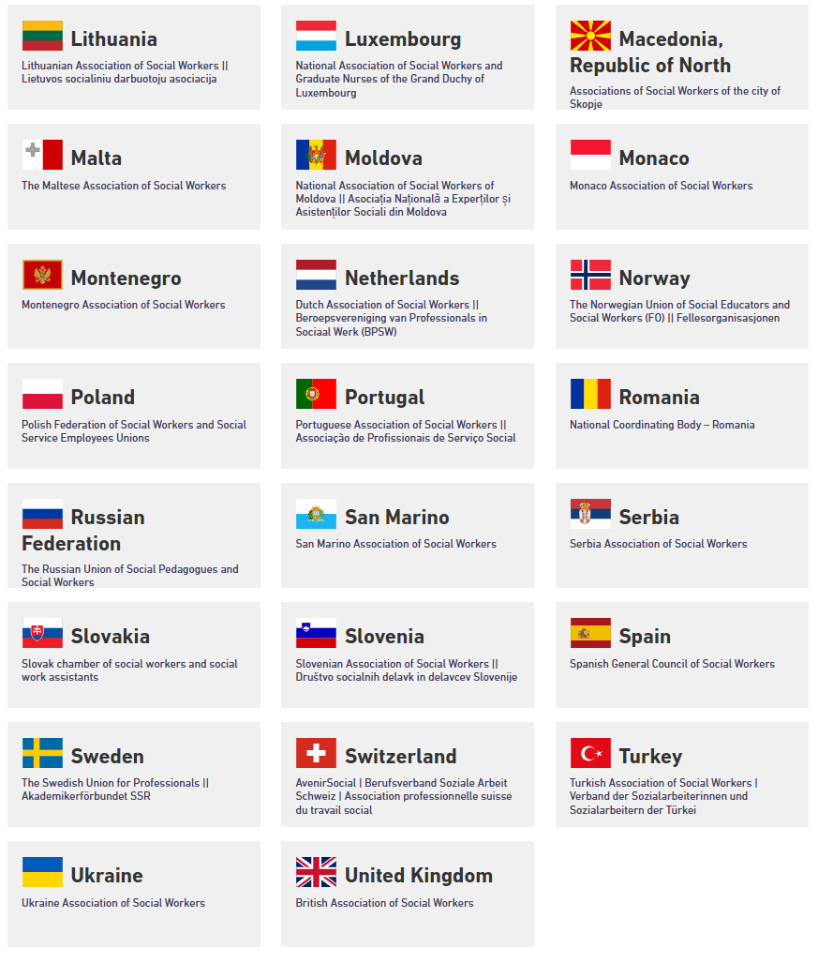
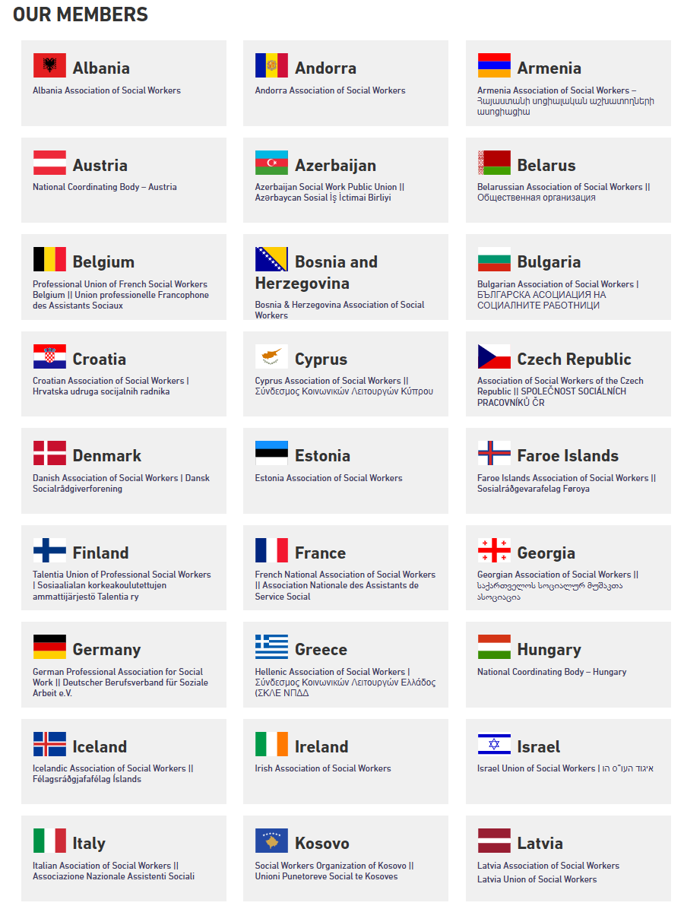
Our Region

Slide 21

Supporting Social Workers and Social Care
Promoting
Promoting better working conditions
Advocating
Advocating for recognition and values of the social work and social care
Providing
Providing support for identity, confidence and collective voice
Encouraging
Encouraging international learning and celebration of social work and social care

Slide 22
Thank you for all you do!
Dr Ruth Allen
europe@ifsw.org

