Slide 1





Update on the Work of the New Social Workers Network
Presented to IFSW Europe Delegates Meeting 2026
New Social Workers Network
Email address: newsocialworkers@ifsw.org
Notes:
OM
1

Slide 2

TODAY: PROGRESS, POLICY, DECISION
  01 Progression in 2025–2026
  02 Why intergenerational working matters
  03 What the policy commits IFSW Europe to
  04 What adoption means in practice
  05 Decision requested from Delegates
2
Notes:
[Sources]
- NSWN Update for IFSW Europe DM 2026.docx; Policy Paper.docx
[/Sources]
2

Slide 3
ONE YEAR LATER: A NETWORK SCALING UP
20 → 68
15
members
countries now represented
A year of growth, stronger governance and increased representation.
  Privacy notice established as the foundation for a managed membership database
  New-member induction supports participation across IFSW Europe, its networks and projects
3
Notes:
[Sources]
- NSWN Update for IFSW Europe DM 2026.docx
[/Sources]
3

Slide 4
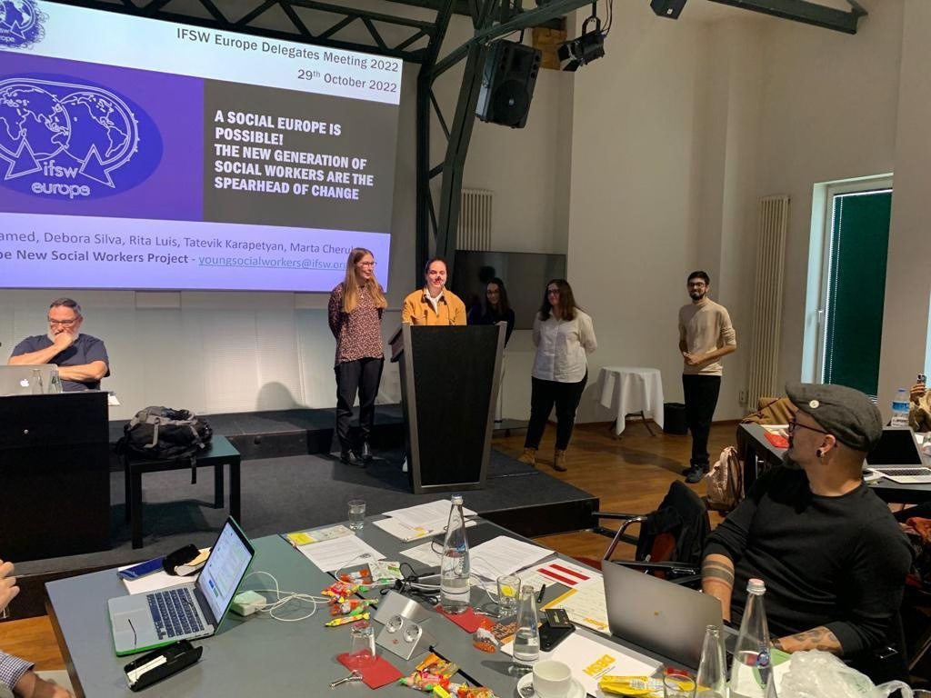
GOVERNANCE BUILT FOR PARTICIPATION
  Elections completed: two Co-Chairs
  Named leads for Funding, Social Media, Membership, Events and Federation Link
  Federation Lead shares opportunities and attends regular representatives’ meetings
  New social workers are moving from network membership into Federation participation, e.g. involvement in CINGO, ESN, EAPN, and more!
FROM NETWORK → PARTICIPATION → LEADERSHIP
4
Notes:
[Sources]
- NSWN Update for IFSW Europe DM 2026.docx; photo reused from NSWN_Delegates_Update_2025.pptx
[/Sources]
4

Slide 5
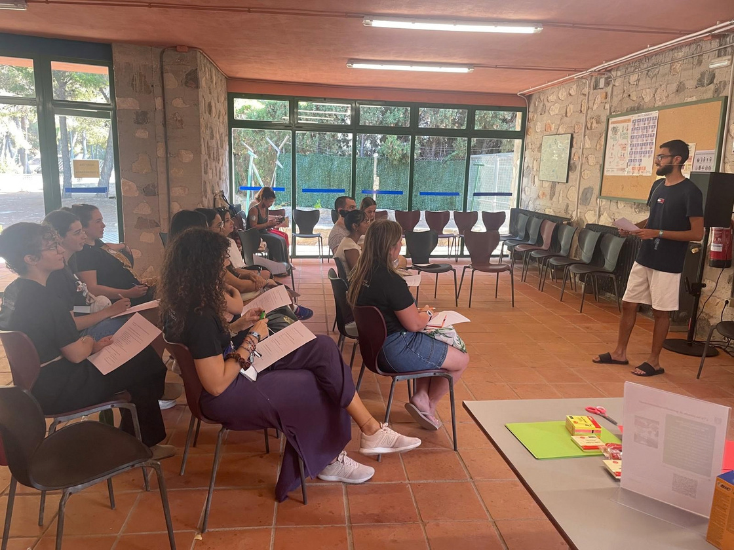
VISIBILITY, LEARNING AND CONNECTION
  Webinars, events and a blog have amplified new social worker perspectives
  Recruitment poster remains a practical route into the Network
  NSWN will contribute through existing IFSW Europe social media channels, strengthening integration rather than creating separate accounts
  Induction and event activity create pathways into wider Federation work
5
Notes:
[Sources]
- NSWN Update for IFSW Europe DM 2026.docx; photo reused from NSWN_Delegates_Update_2025.pptx
[/Sources]
5

Slide 6


Slide 7
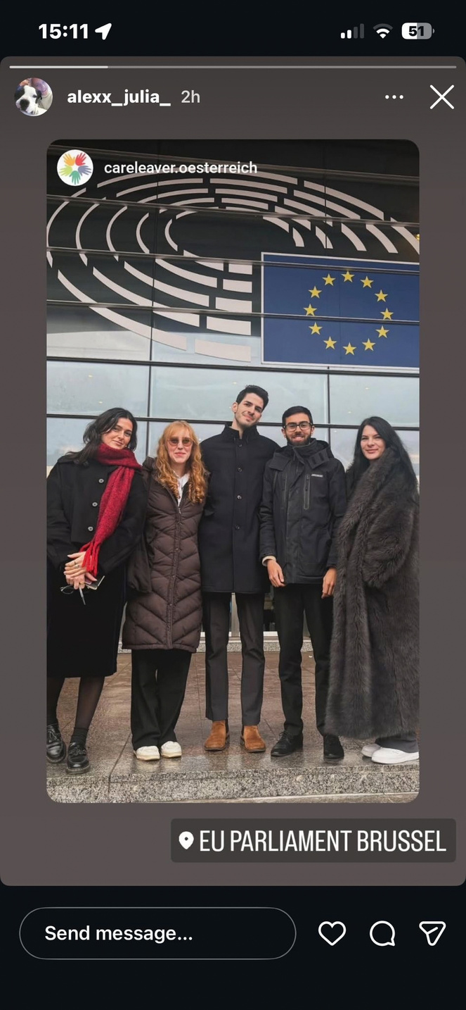
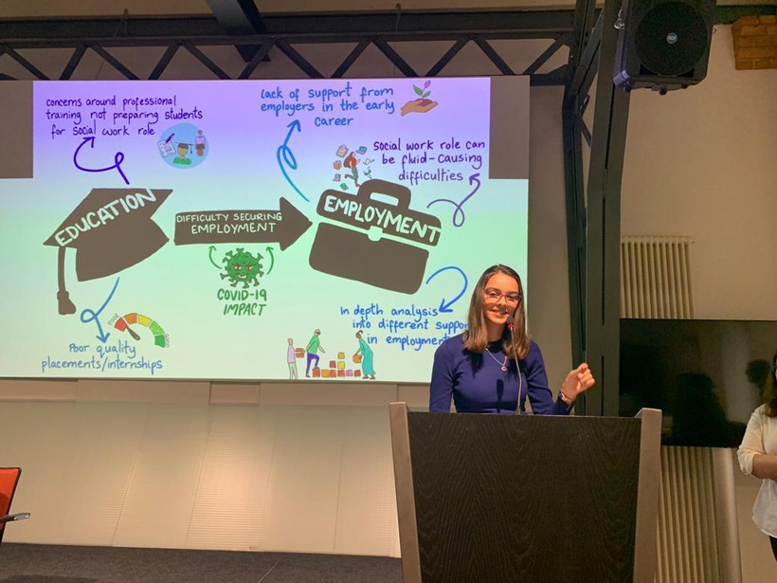
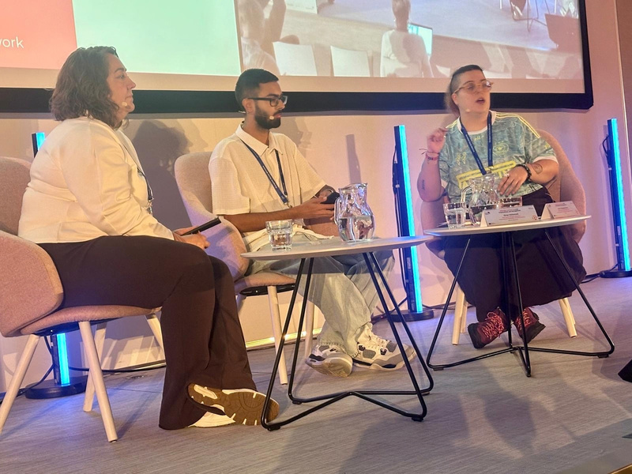
GROWING OUR EUROPEAN AND INTERNATIONAL REACH
  Helsinki: funded to present on preparing new social workers for disasters, 23–26 September 2026
  Bucharest: abstract accepted for an international social work conference, 3–6 November 2026
  Brussels: two NSWN members joined a RESPONSIVE project event
  Strasbourg: NSWN representation at CINGO
  Utrecht: approximately six NSWN members funded to attend this Delegates Meeting
6
Notes:
[Sources]
- NSWN Update for IFSW Europe DM 2026.docx; photo reused from NSWN_Delegates_Update_2025.pptx
[/Sources]
7

Slide 8
SUSTAINABILITY: BUILD CAPACITY, THEN SCALE
FUNDING
NEXT STEP
  Funding opportunities identified
  Meetings held with grant-funding and bid-writing experts
  Substantial Erasmus funding bid planned for 2026–2027
  Convert participation into sustainable Federation collaboration
  Strengthen grant-writing capacity and external funding pipeline
  Support representation without relying only on individual resources
7
Notes:
[Sources]
- NSWN Update for IFSW Europe DM 2026.docx
[/Sources]
8

Slide 9
FROM LAST YEAR’S ACTION PLAN TO DELIVERY
MEMBERSHIP
GOVERNANCE
VISIBILITY
68 members +
new nominations
Elections +
designated leads
Webinars, blog,
events, poster
FEDERATION
FUNDING
POLICY
Regular representation
and opportunities
Bid capability +
Erasmus plan
Paper ready
for adoption
8
Notes:
[Sources]
- NSWN Update for IFSW Europe DM 2026.docx
[/Sources]
9

Slide 10

POLICY PROPOSAL: INTERGENERATIONAL WORKING FOR A SUSTAINABLE FEDERATION
THE PROPOSITION
Intergenerational working becomes a core organisational principle within IFSW Europe.
Continuity + Innovation + Shared leadership + Sustainability
The NSWN is an integral part of IFSW Europe, not a separate entity.
9
Notes:
[Sources]
- Policy Paper.docx, sections 1, 3 and 6
[/Sources]
10

Slide 11

WHY INTERGENERATIONAL WORKING?
EXPERIENCED SOCIAL WORKERS
NEW SOCIAL WORKERS
  Professional and organisational knowledge
  Institutional memory and governance expertise
  Mentorship, stability and strategic direction
  Contemporary research and practice knowledge
  Digital competencies and emerging perspectives
  Innovation, energy and future-facing capacity
RECIPROCAL MENTORSHIP: LEARNING FLOWS BOTH WAYS
10
Notes:
[Sources]
- Policy Paper.docx, section 2
[/Sources]
11

Slide 12
FOUR PRINCIPLES DELEGATES ARE BEING ASKED TO ENDORSE
1
Mutual respect
Value professional and lived experience across generations.
2
Meaningful participation
New social workers influence decisions, agendas and initiatives.
3
Shared leadership
Redistribute opportunities and co-lead alongside experienced colleagues.
4
Reciprocal learning
Knowledge is co-constructed, not simply passed down.
11
Notes:
[Sources]
- Policy Paper.docx, sections 2 and 4
[/Sources]
12

Slide 13
WHAT ADOPTION CHANGES IN PRACTICE
  Governance: joint participation in meetings and decision-making
  Projects & policy: co-production, consultation and shared project leadership
  Representation: pathways to commissions, external organisations and Federation roles
  Leadership pipeline: mentorship plus real opportunities to lead
  National associations: encourage new social worker
  representation on Boards and committees, with practical and financial support
NOT A SEPARATE ACTIVITY
A core way of working across governance, policy, projects, communication and professional networks.
12
Notes:
[Sources]
- Policy Paper.docx, sections 5, 7 and 8
[/Sources]
13

Slide 14
HOW WE WILL KNOW IT IS WORKING
01
Leadership development
02
Retention in professional associations
03
Participation in governance
04
Perceived influence in decisions
05
Sustainability of initiatives
Evaluation should inform continuous development, not become a one-off exercise.
13
Notes:
[Sources]
- Policy Paper.docx, section 9
[/Sources]
14

Slide 15
A PRACTICAL MODEL: COLLABORATE ACROSS THE WHOLE PATHWAY
CONNECT
LEARN
CONTRIBUTE
LEAD
→
→
→
Networks • induction
Mentoring • reciprocal mentoring
Projects • policy • consultations
Governance • representation • co-leadership
The policy turns intergenerational working from good intention into an organisational habit.
14
Notes:
[Sources]
- Policy Paper.docx, sections 5, 7 and 10
[/Sources]
15

Slide 16
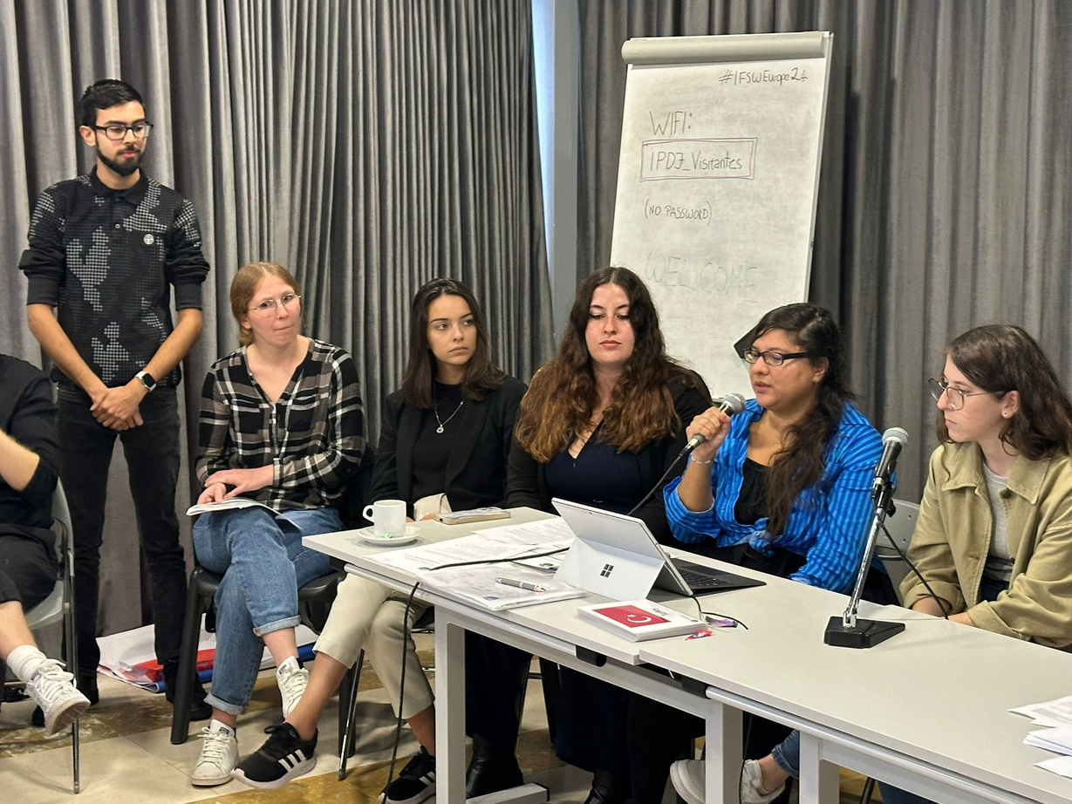
WHAT WE ASK OF MEMBER ASSOCIATIONS
  Create opportunities for experienced and new social workers to work together
  Support local new social worker groups
  Include new social workers in Boards, committees and governance structures
  Provide financial and practical support for participation at national and European meetings
  Share good practice examples so that learning travels across Europe
15
Notes:
[Sources]
- Policy Paper.docx, sections 8 and 10; photo reused from NSWN_Delegates_Update_2025.pptx
[/Sources]
16

Slide 17



PRIORITIES FOR 2026–2027
Expand and diversify membership through member-association nominations
Build the detailed membership database and deepen induction
Create further pathways into Federation activity and representation
Progress the Erasmus application and wider funding opportunities
Use IFSW Europe channels, webinars, blogs, events and the recruitment poster to increase engagement
If adopted, support implementation of the intergenerational working policy
16

Slide 18

DECISION REQUESTED FROM DELEGATES
ADOPT
the policy paper, “Intergenerational Working for a Sustainable Federation”.
By voting yes, Delegates endorse intergenerational working as a core organisational principle and a practical route to continuity, innovation and shared leadership.
VOTE FOR ADOPTION
17
Notes:
[Sources]
- Policy Paper.docx, sections 3, 7 and 11
[/Sources]
18

Slide 19

THANK YOU
A sustainable Federation is built when generations work together, learn together and lead together.
NEW SOCIAL WORKERS NETWORK
newsocialworkers@ifsw.org
Questions • Discussion • Vote
18
Notes:
[Sources]
- Policy Paper.docx; NSWN Update for IFSW Europe DM 2026.docx
[/Sources]
19

