Slide 1
Social Work in Times of Uncertainty:
Discussion of challenges & Innovative Solutions
20:45 Welcome
21:00 Opening keynote
21:15 Presentation of survey results
21:25 How Italy is responding?
21:35 How Portugal is responding?
21:45 How Israel is responding?
21:55Q&A

Slide 2
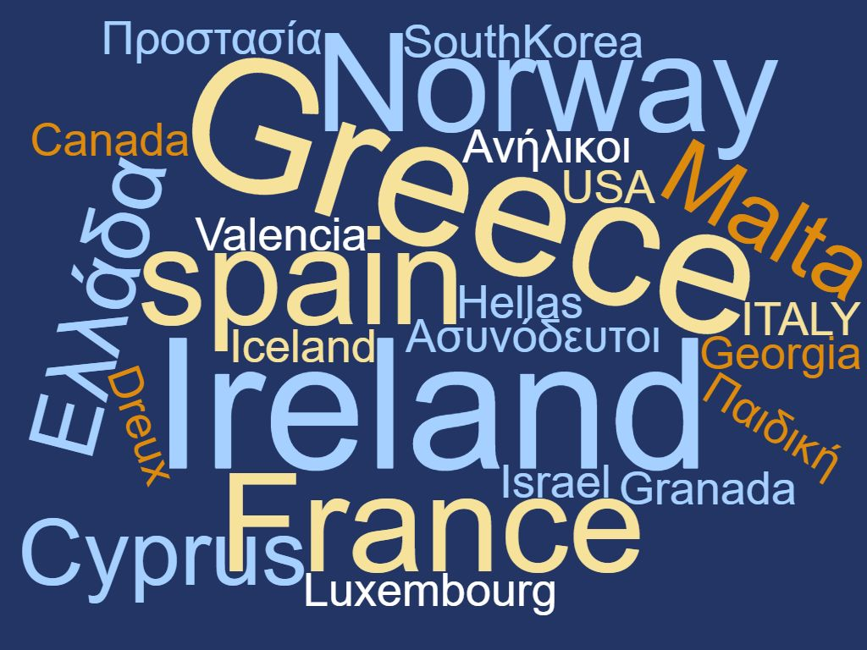

Slide 3
From where your work is being done these days?
HOME
44%
WORK
37%
BOTH
19%
Notes:
Are you working from home?
No – 83
Yes – 97
Both - 42

Slide 4
How are you able to maintain contact with your clients?
4.5%
39.5%
40.5%
42%
71%
94%
Notes:
How are you able to maintain contact with your clients?
Telephone – 207 (32%)
Email – 156 (24%)
Face to face – 92 (14%)
Skype, Zoom, internet – 88 (14%)
Social media or SMS – 86 (14%)
Apps – 10 (2%)

Slide 5
What are your main activities during this emergency?
58.7%
83.4%
Notes:
What are your main activities during this emergency?
Emotional support – 182
Financial assistance – 75
Providing food – 91
Emergency intervention for family violence against children/women/elderly – 60
Parenting advice – 81
Information about rights – 128
Support/assistance following death of a family member – 39
medical assistance/access to prescription medications– 67

Slide 6
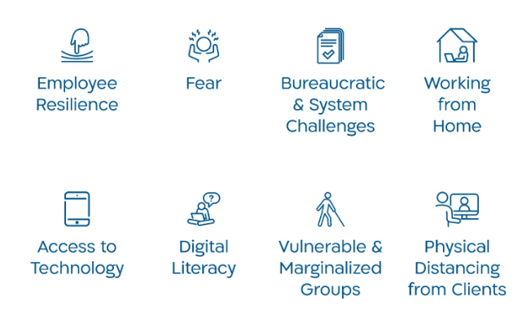
Dilemmas & Challenges

Slide 7
Dilemmas & challenges examples
Resilience: I am exposing myself and indirectly my family to an increased level of risk - but I strongly feel that I have a duty to my clients to be there
The danger to ourselves and our clients when we meet face to face
Technology: How to build a relationship with clients without any real live meetings
Our services are digitalized, but not all of our clients have the skills - or even have internet at home.
Social distancing: Difficult to support immigrants, refugees, homeless and drug users.
Establishing alliances/relations with new clients

Slide 9
Innovation – examples
“Social Work is going digital: Utilizing apps and technology – WhatsApp, Teams, Zoom, YouTube, and social media to communicate with clients”
“Design of new registration tools, online training, phone screening, online exercise programs based on need of departments and social workers.”
“Introduction of phone screening for new referrals for immediate needs and assessment of emotional support using RAPID”
An Icelandic entrepreneur has developed an online therapy platform that has been approved by the authorities whereas Skype and social media are not safe. On this platform you can take live interviews and connect with the client.
We have developed 24h telephone attention shifts widening our attention outside of our normal schedules in order to deal with emergencies and urgent issues.

Slide 10
Lessons learned & suggestions to colleagues
Digital interventions: “The role of social work has already changed”
Emotional support: “Don't stop believing in yourselves. Support colleagues and solidarity”
Personal safety: “We should take into account our safety also”.
Professional practice: “Focus and identify priorities of intervention. Be active to contact patients, identify who needs support”
”We have to adapt our work from face to face to remote and we should examine all the alternatives such as social apps”.
“Focus and identify priorities of intervention. Be active to contact patients, identify who needs support, because unemployment will raise and the source of income have diminished”

